Slide 1
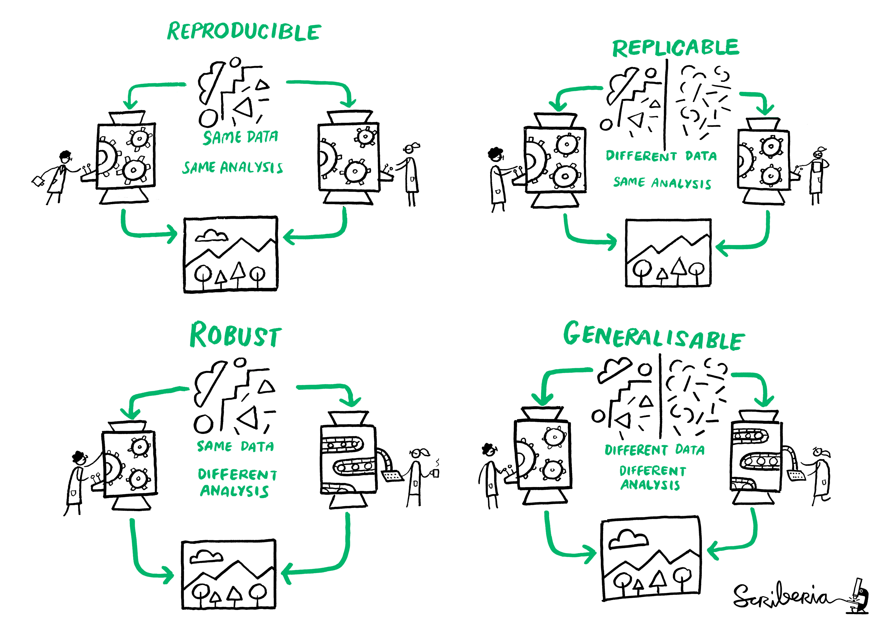
Computational reproducibility for bioinformatics analyses
DEVOPS
AMRIT SINGH, PHD
AUTOMATE
May 11, 2021
Notes:
Play video on a reproducible workflow:
https://www.youtube.com/watch?v=s3JldKoA0zw&ab_channel=bartomeuslab

Slide 2
https://www.youtube.com/watch?v=s3JldKoA0zw&ab_channel=bartomeuslab

Slide 3
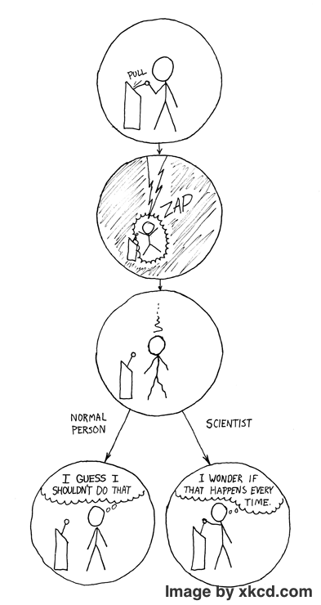
TABLE OF CONTENTS
BACKGROUND
SIMPLE WORKFLOW
SUMMARY
“”
Reproducibility crisis: computational reproducibility
4 steps to a reproducible workflow
Additional tooling; Concluding remarks

Slide 4

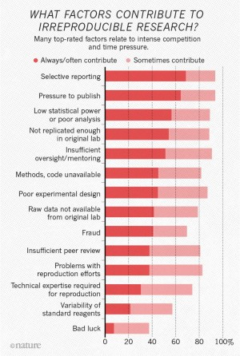
IRREPRODUCIBLE RESEARCH
CODE
Nature’s survey of 1,576 researchers found 70% of researchers said they failed to reproduce another scientists research¹.
Analyses have shown a reproducibility rate of 10% in preclinical cancer research².
CODE
¹Nature 533, 452-454 (2016)
²Nature 484, 531-533 (2012)
code available but doesn’t work

Slide 5
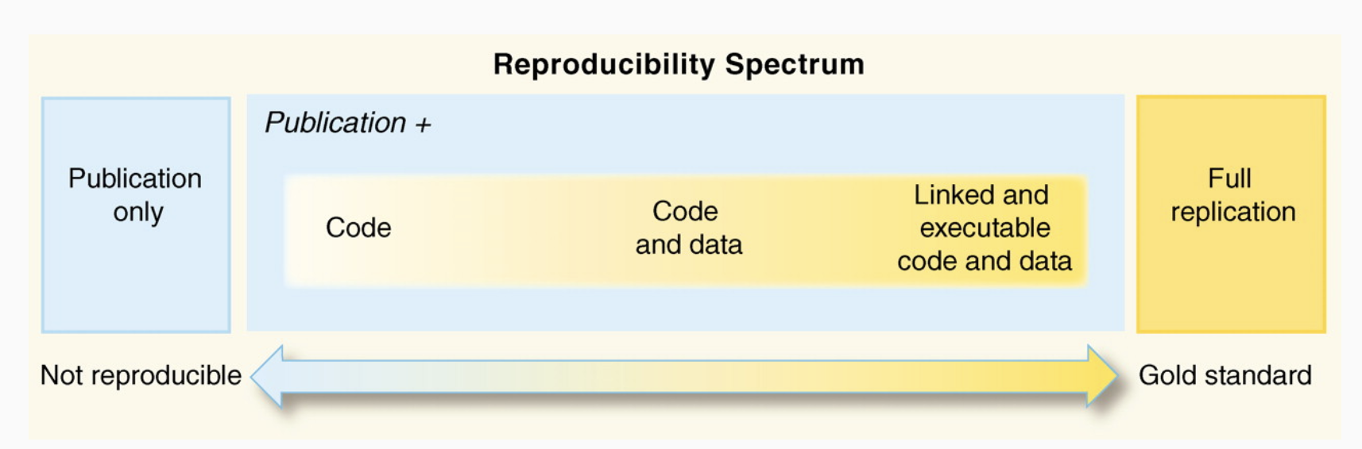
NEVER BEEN EASIER
!!!!!!!!!!!
REPRODUCIBLITY
https://annakrystalli.me/talks/r-in-repro-research.html

Slide 6
SIMPLE WORKFLOW – paper
01
From rmarkdown.rstudio.com:
R Markdown documents are fully reproducible. Use a productive notebook interface to weave together narrative text and code to produce elegantly formatted output. Use multiple languages including R, Python, and SQL.
R Markdown supports dozens of static and dynamic output formats including HTML, PDF, MS Word, books, shiny applications, scientific articles etc.
Pandoc is used to convert Rmarkdown into varius formats (https://pandoc.org/)
Current process
Get data (.sh)
Run analysis (.py)
Visual results (.r)
Write paper (manually make word document)
PHATE: Nature Biotechnology 37, 1482-1492 (2019)
https://bookdown.org/yihui/rmarkdown/
https://www.rstudio.com/wp-content/uploads/2015/02/rmarkdown-cheatsheet.pdf
Notes:
- Remove copy paste when writing manuscripts

Slide 7
https://youtu.be/uyE6eFUYdwg
pandoc arguments: https://github.com/pandoc/lua-filters; R packages: rticles, citr
Get .csl file from: https://github.com/citation-style-language/styles; https://www.zotero.org/styles
Get .bib from citation manager; https://annakrystalli.me/rrtools-repro-research/paper.html
https://ctan.org/pkg/booktabs?lang=en: booktabs (publication quality tables), longtable (allow tables to flow over page boundaries)

Slide 8
Makefile
02
!!!!!!!!!!!
Target: prerequisites…
<1 TAB>recipe…
<1 TAB>recipe…
target: filename of generated file or name of action
prerequisites: file(s) used to create the target file/action
recipe: commands that make carries out
”software building automation tool that will execute repetitive tasks for you”
A Makefile (tells make what to do) consists of rules that specify relationships between files; divide analysis into a series of steps; re-run steps as needed
WORKFLOWS
https://www.gnu.org/software/make/manual/make.html
https://cpb-ap-se2.wpmucdn.com/blogs.auckland.ac.nz/dist/1/411/files/2018/12/1_peterBaker_AASC18_talk-1aiphvo.pdf
Notes:
- Tell other people what commands who took to get the results

Slide 9
https://youtu.be/YqYAFJGccPk

Slide 10
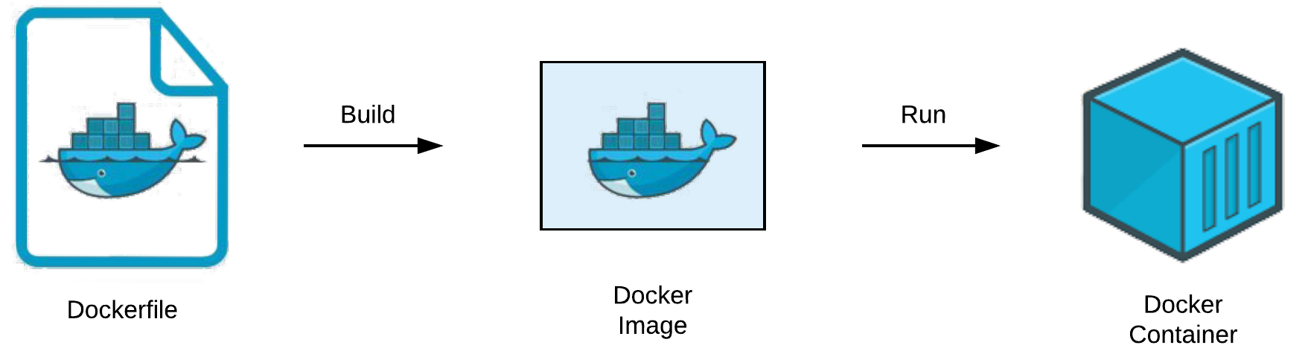
DOCKERFILE
IMAGE
CONTAINER
Docker
03
Provides an isolated environment for your analysis or applications.
Text file with a set of instructions for installing software, adding data, running analyses or applications.
FROM rocker/verse:4.0.2
COPY . .
RUN Rscript code/libs.r
Built from a dockerfile; set of files (layers)
An isolated running process: instance of an image
docker build -t user/repo .
docker run -p port1:port2 -t user/repo
Download docker: https://docs.docker.com/get-docker/
Docker registry: https://hub.docker.com/
Docs: https://docs.docker.com/

Slide 11
https://youtu.be/WF7JC7wSKAU
https://github.com/nuest/ten-simple-rules-dockerfiles

Slide 12
SHARING IS CARING
04
DOCKERHUB
#1
docker push user/repo:version
Public repository for docker images
Make GitHub repo
Add folder to Github
git --version
git init
git add .
git commit –m “project setup”
git push origin main
GITHUB
#2
Public/private hosting of folders (repositories) with Git integration + project management
Install Git: https://git-scm.com/book/en/v2/Getting-Started-Installing-Git
github keys: https://docs.github.com/en/github/authenticating-to-github/generating-a-new-ssh-key-and-adding-it-to-the-ssh-agent

Slide 13
https://youtu.be/6XOErd3zs3E

Slide 14

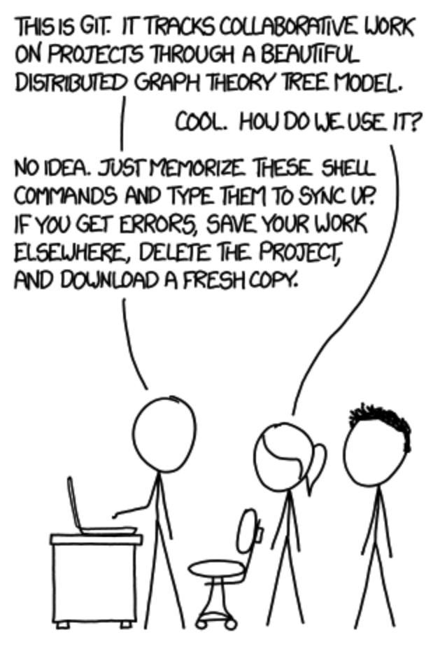
VERSION CONTROL USING GIT
https://www.coursera.org/learn/introduction-git-github?specialization=google-it-automation

Slide 15
Some final thoughts
!!!!!!!!!!!
Only copy and paste from Google (code, beware of conversion errors).
Type less; learn key shortcuts
Package repetitive tasks into Python modules or R packages with versioning for future re-use.
Add continuous integration, continuous delivery (e.g. .travis.yml) to continuous re-build dockerfile and run tests
develop a front-end that automagically scaffolds the code for you and saves to a GitHub repository.
REPRODUCIBLITY

Slide 16
A TOOLKIT FOR COMPUTIONAL REPRODUCIBILITY

Slide 17
THANKS!
Do you have any questions?
asingh.analytics@gmail.com | @asingh_22g | amritsingh.ca
Source repo: https://github.com/singha53/reproducible_analysis_demo

Slide 18


